Slide 1
Dissection of flower
Gladiolus

Slide 2

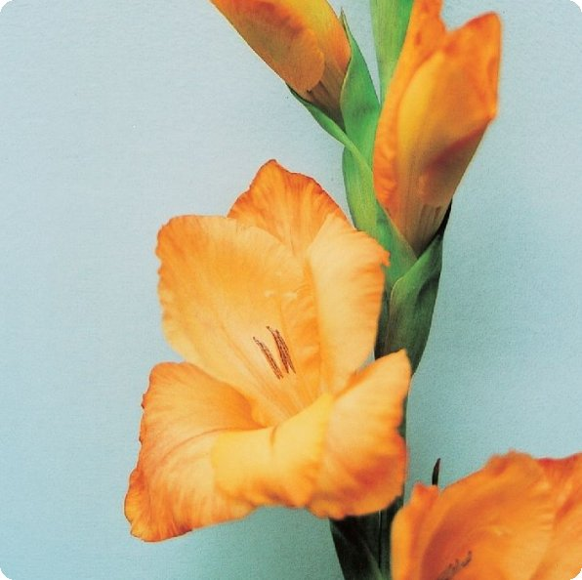
Examination of a flower
Procedure:
1 Record the number, size and colour of the petals of a Gladiolus flower and a grass flower.
Gladiolus flower

Slide 3
Procedure:
2 Record the number of stamen and the way in which the anthers are attached to the filaments and the position of the anthers.
Gladiolus flower

Slide 4
21.6
Examination of an insect-pollinated flower and a wind-pollinated flower
Procedure:
3 Note the size and the position of the stigmas.
Gladiolus flower

Slide 5
21.6
Examination of an insect-pollinated flower and a wind-pollinated flower
Procedure:
4 Examine whether there is any nectary present in the flowers.
5 Determine whether the flowers are insect-pollinated or wind-pollinated.
Gladiolus flower

Slide 6
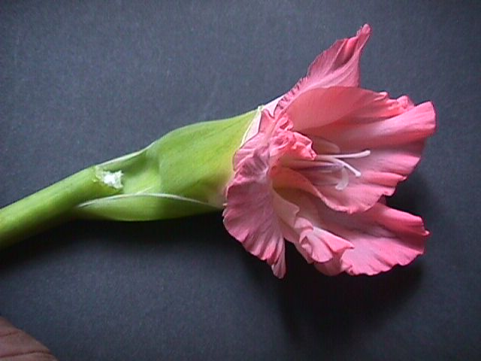
petal
anther
stigma
Flower stalk
sepal

Slide 7
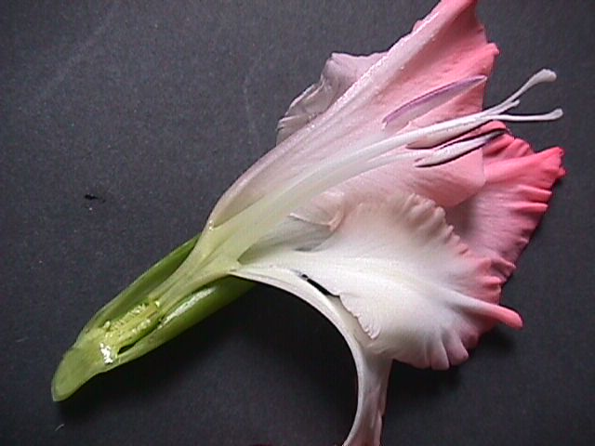
carpel
ovary
style
stigma
anther
stamen
filament
receptacle
sepal
petal

Slide 8
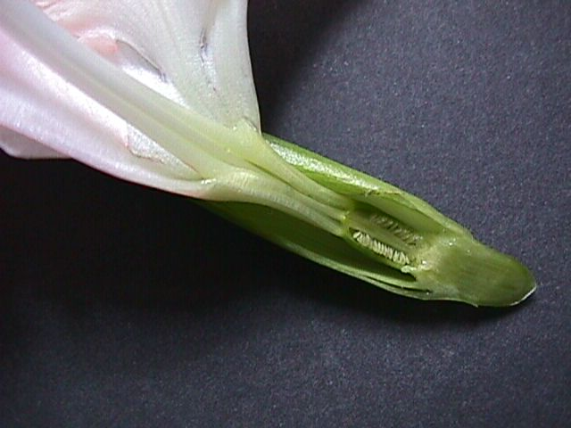
ovule

Slide 9
Name______ ( ) F.4 __ Date:_________
Dissection of a Gladiolus flower
Table showing the adaptive features of a Gladiolus flower to its way of pollination
Floral parts | Features | Adaptation
Sepal ( )
Petal ( ) (Insect guide present?)
Stamen ( )
Carpel ( )
scent | present / absent
Nectary | Present / absent
Drawing of the Gladiolus flower
Title and magnification
Gladiolus flower is __________________

Slide 10
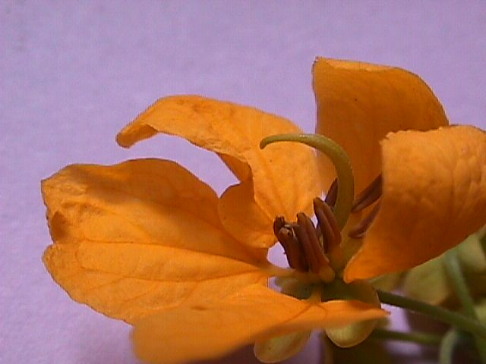
stigma
style
carpel
ovary
anther
stamen
filament
Petal
sepal

Slide 11
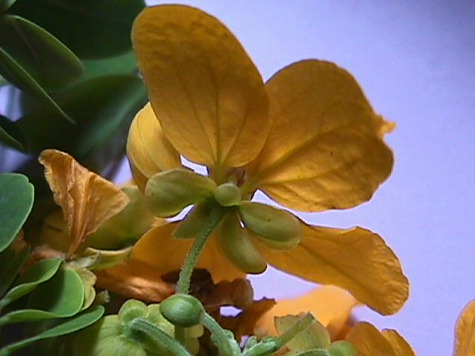
sepal
Flower stalk
Flower bud

Slide 12
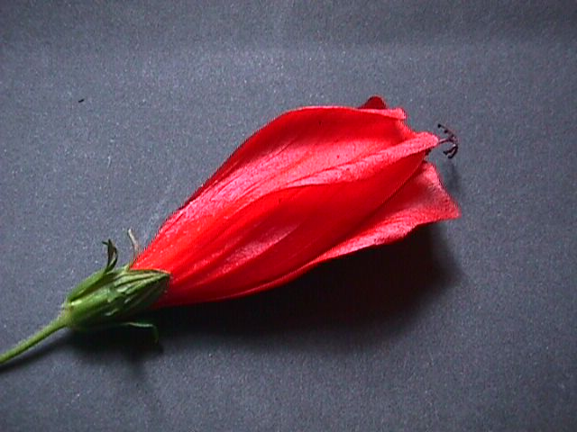
stigma

Slide 13
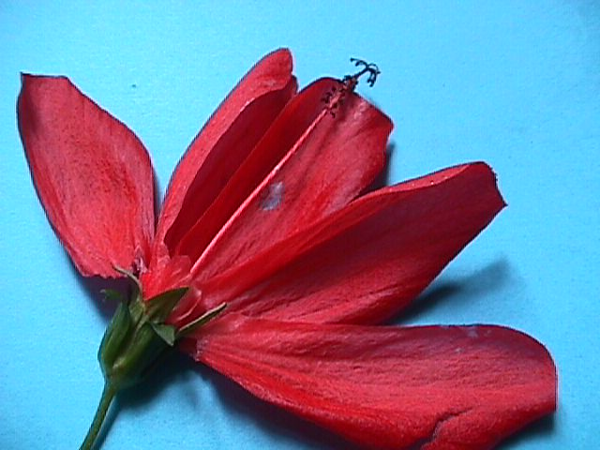
style
anther
Filament (form a tube)

Slide 14
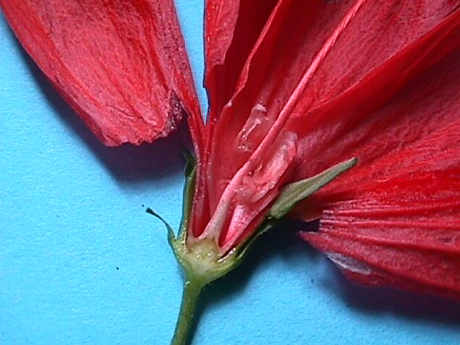
ovary
receptacle
Flower stalk

